Slide 1

FACTORY QC
Application Guide
Mar 2024
© 2023 Vision Group

Slide 2
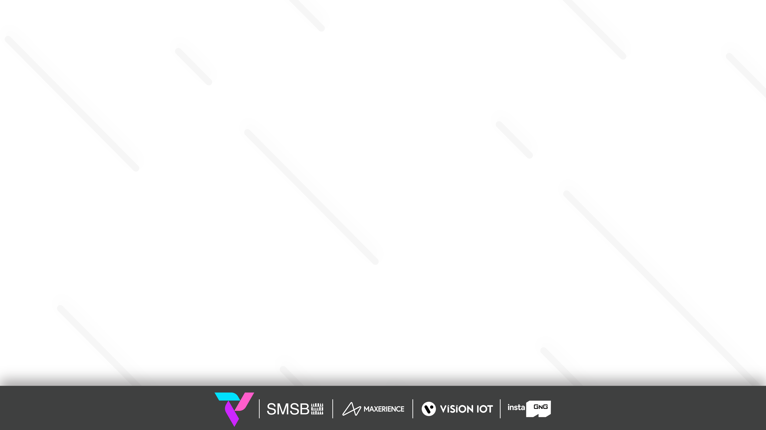
APPLICATION FEATURES
Association QC – To check the Associated Status of the Smart Device with the Cooler in Factory.
QC Details – To Show the Successful Association QC Details by Date with a message.
QC Overview – To Show the Overall summary based on the Error and Success Message.
Smart Device Check – To Check the QC Status of Smart Devices.
Cooler Check – To Check the QC Status of the Cooler.
GMC5 Check – To Check the QC Status of GMC5 Smart Devices.
Aon Connectivity Check – To Check the AON device advertisement and ping data.
Aon Connectivity Check Log – To Check the AON device advertisement and ping data logs.
© 2023 Vision Group

Slide 3
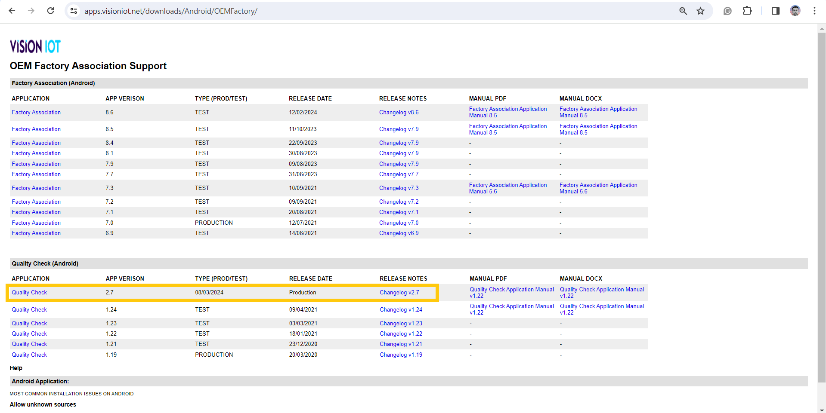
APPLICATION INSTALLATION
Install the “FACTORY QC” APK received from an Android phone link.
URL: https://apps.visioniot.net/downloads/Android/OEMFactory/
The Factory QC application is compatible only with Smartphones having Android V9.0 and above.
Open VISION IOT’s Factory QC Application.
Log in to the application using the credentials provided by your administrator.
Suggested Note: Before installing every new version, Logout and delete the previous version.
Note: Please ensure Bluetooth, mobile Wi-Fi, or Mobile Data are ON in the device.
© 2023 Vision Group

Slide 4
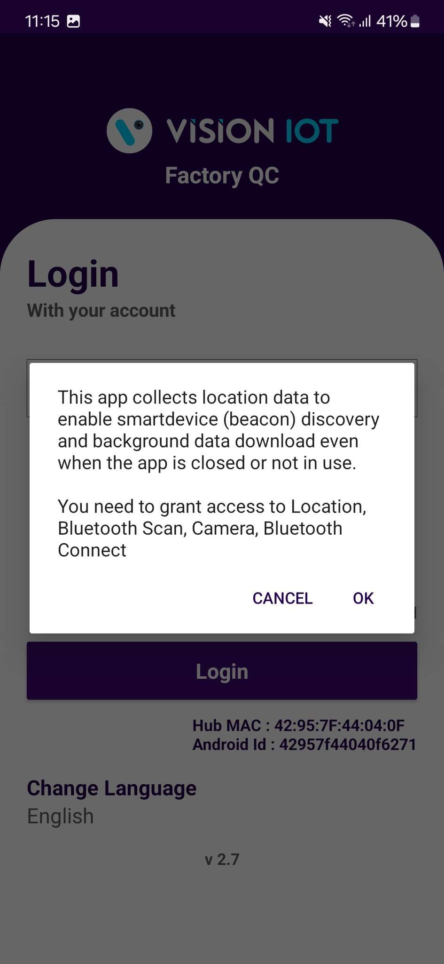
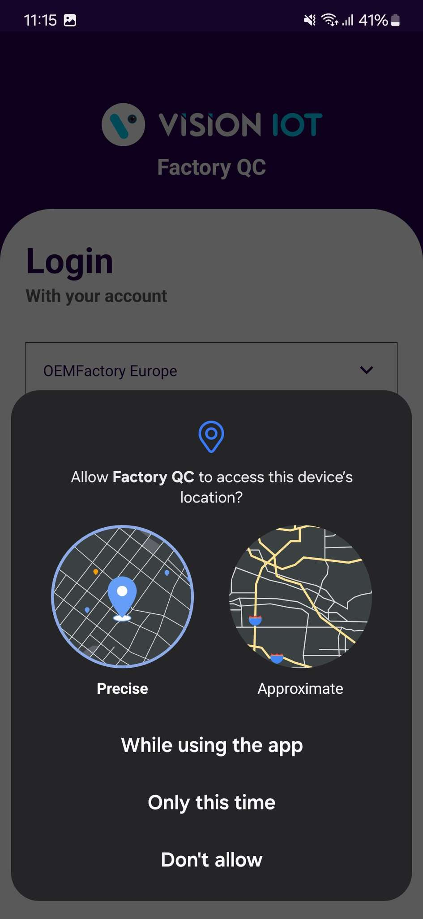
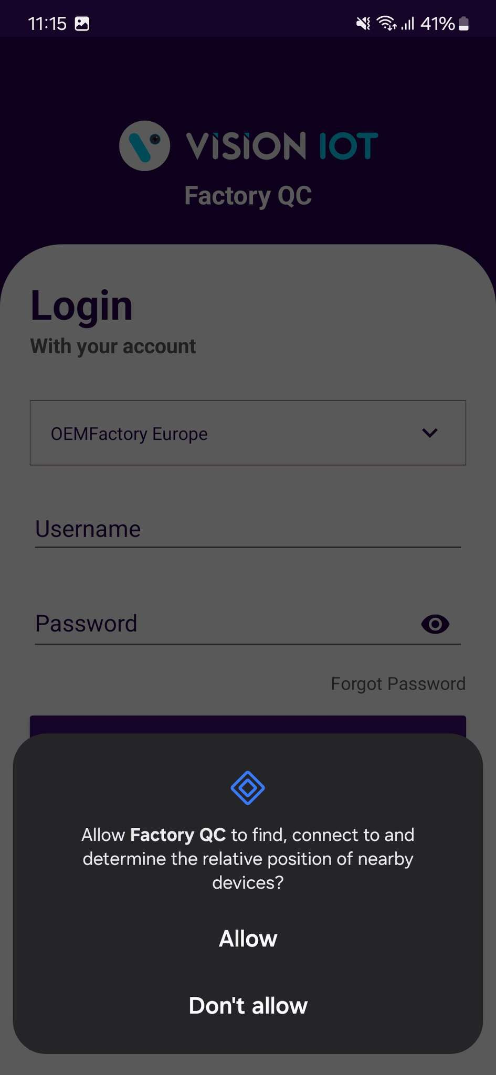
APPLICATION PERMISSION
After initial installation and launch, the Application will ask for permission to access.
Choose Server: For CCH and CCEP the user can use the OEM Factory Europe server.
Camera Permission, File and Media Permission, Location Permission, Nearby Device Permission Need to Allow.
PERMISSIONS
For Location (so beacons can be found) - Choose Allow While Using App on as per Handset OS.
Then Go to the Phone Settings > App Permissions > Location > Allow Location Access option is “Always”.
Same way Other Permissions like File and Media, Camera, Nearby Device need to Allow.
© 2023 Vision Group

Slide 5
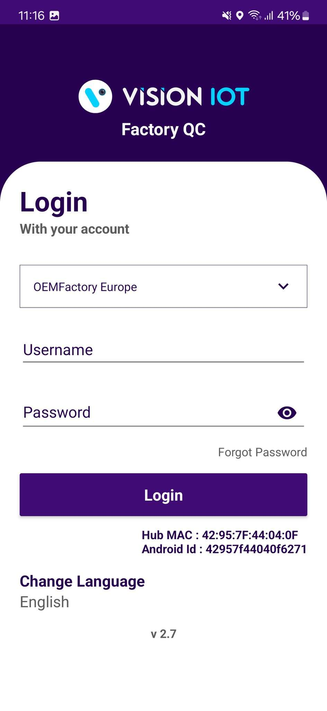
LOGIN
After installing the Factory QC Application, open it and user will be redirected to the Login Page. Choose a server from the list and log in with valid credentials.
Please ensure that Bluetooth is turned on and that location services are enabled.
To log in, the application needs an active internet connection.
After logging in initially, the application can be used in offline mode as long as the same username and password used for the online login are used.
Devices must have at least 4GB of RAM and Bluetooth version 4.2 or higher.
The minimum required operating system version is 9.0 or above.
© 2023 Vision Group

Slide 6
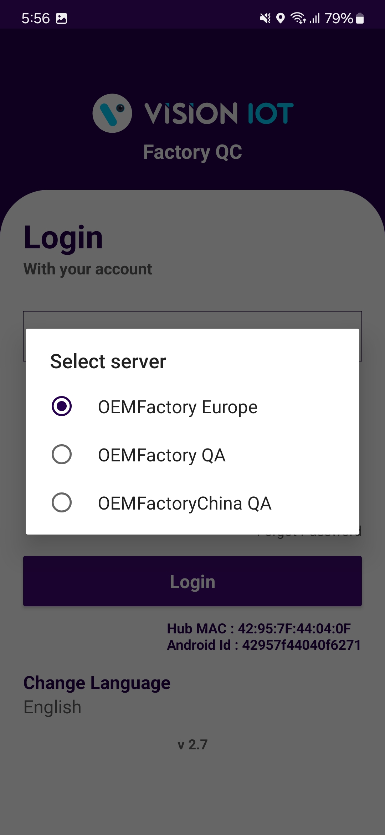
Default OEM Factory Europe Server shows, depending on the Client and Factory user should choose a different option,
  For CCH and CCEP the user can use the OEM Factory Europe server.
To change the language, tap on Change Language and use can choose the language. Currently, there is English language support available.
Depending on the Android Version user may get several different prompts to confirm access to the camera, Bluetooth (location services), Storage, etc.
© 2023 Vision Group

Slide 7

Provide valid credentials and tap on the Login button.
Note: Internet connectivity is required during login otherwise login will fail, and the application will not work.
© 2023 Vision Group

Slide 8
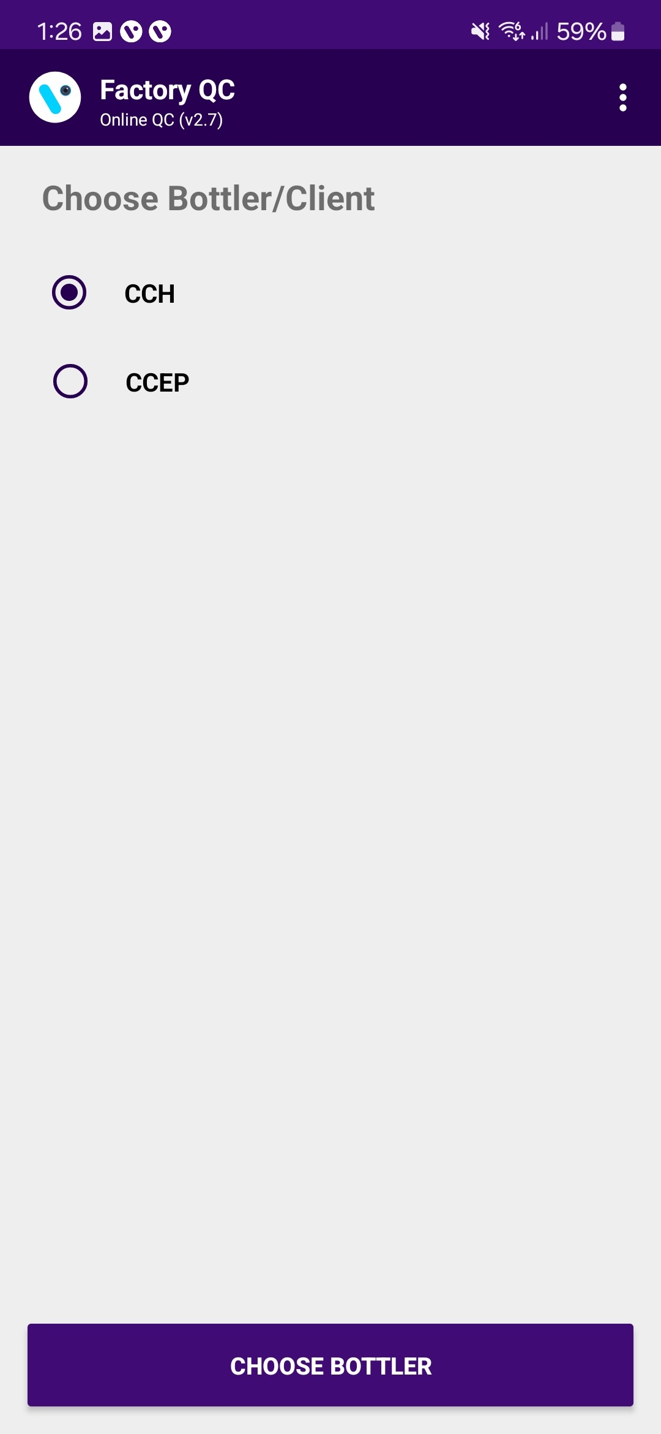
FACTORY QC – SELECT BOTTLER/CLIENT
Users must choose the bottler/client whom they are doing the smart device QC for.
© 2023 Vision Group

Slide 9
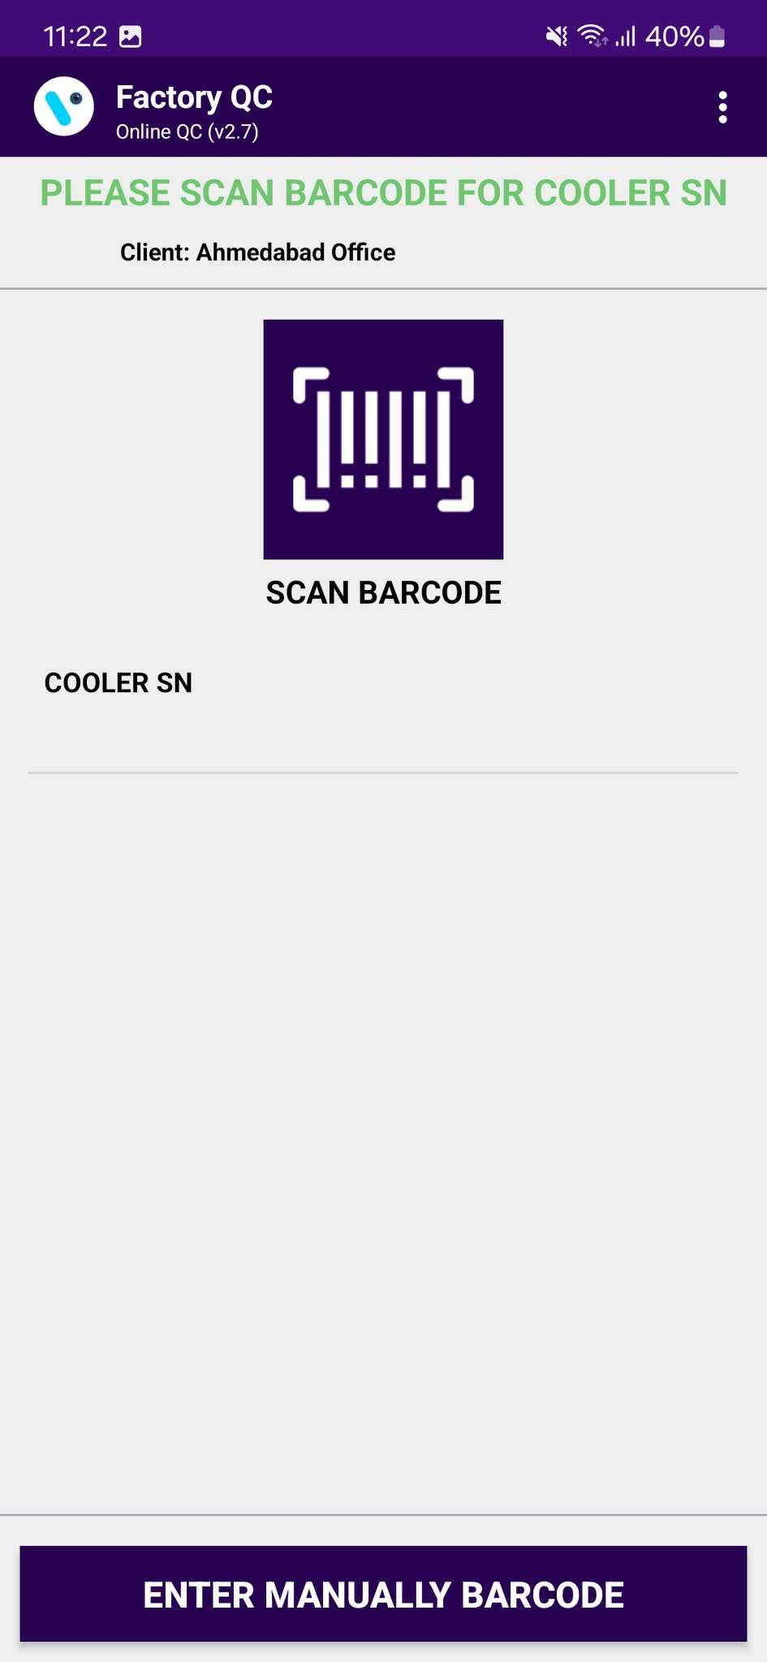
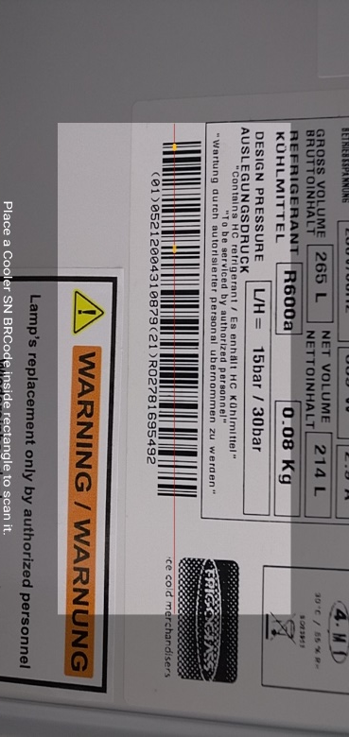
FACTORY QC – SCAN COOLER SN
Tap on SCAN BARCODE and scan the barcode of the cooler. Cooler Serial Numbers could also be entered manually by taping on “ENTER MANUALLY BARCODE”.
© 2023 Vision Group

Slide 10
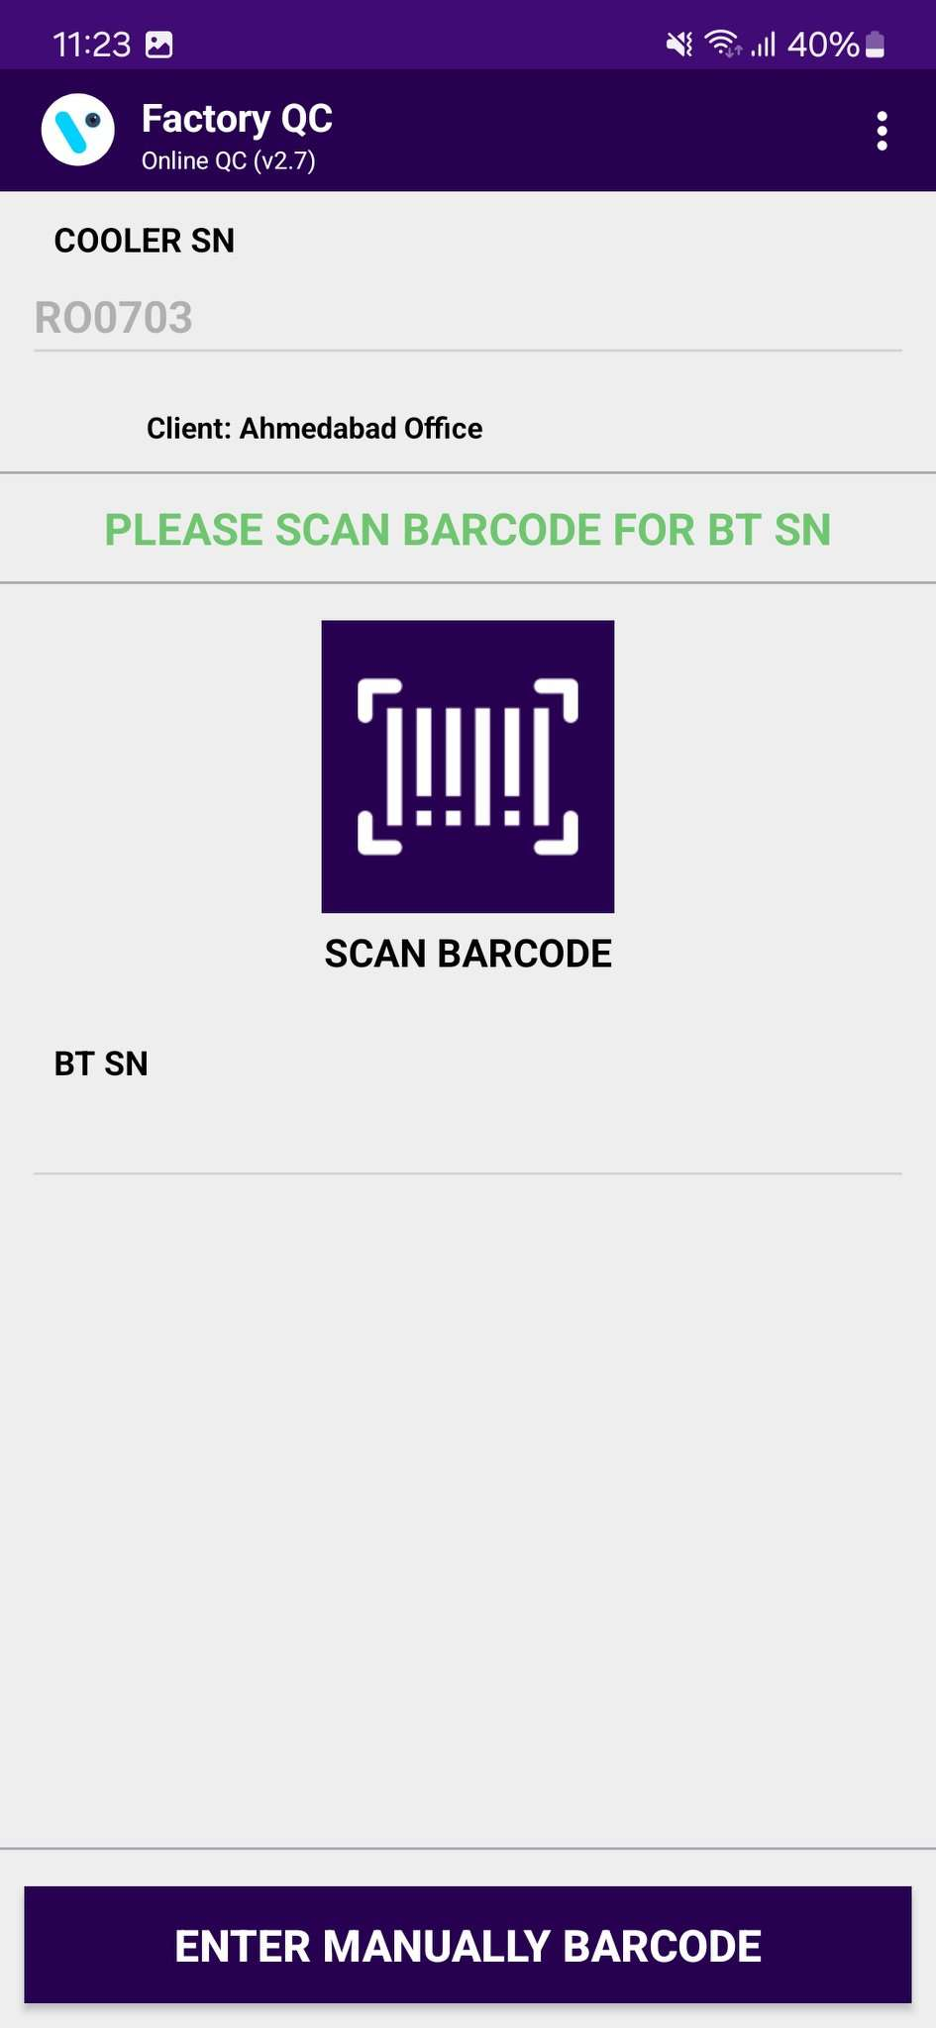
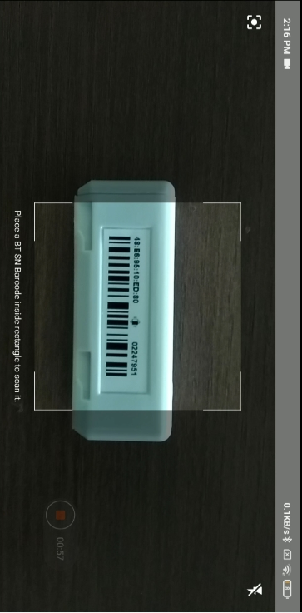
FACTORY QC – SCAN SMART DEVICE SN
After the barcode of the cooler is successfully scanned open and close the door of the cooler to wake up the Smart Device and tap again on SCAN BARCODE for Smart Device Serial and scan the barcode of the Smart Device, smart Device Serial Number could also be entered manually by taping on “ENTER MANUALLY BARCODE”.
© 2023 Vision Group

Slide 11
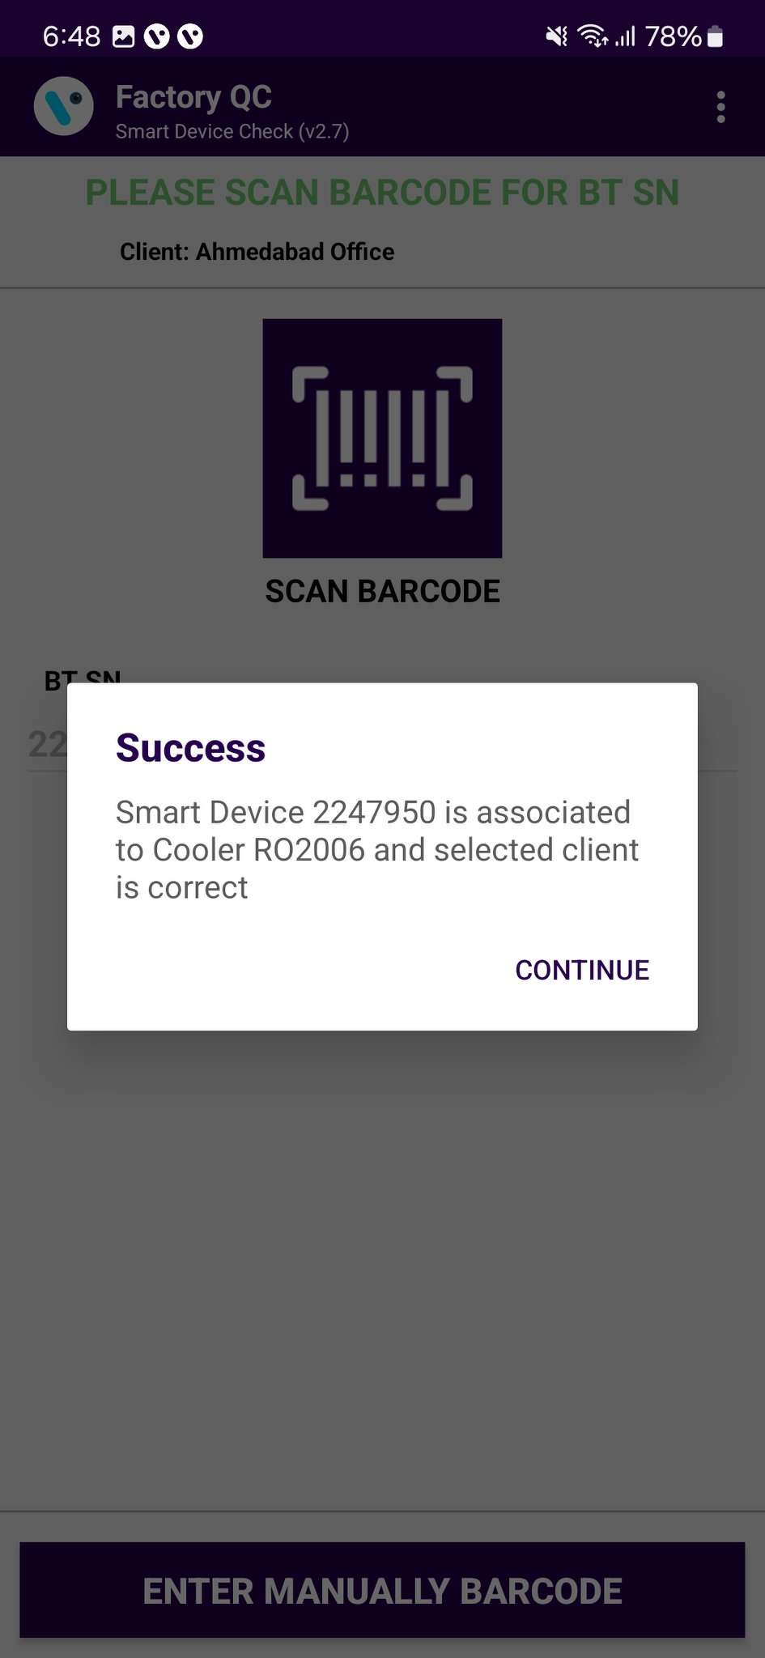
ASSOCIATION – SMART DEVICE CONFIGURATION SETTING UP
After the Smart Device Serial Number is successfully scanned the application will check the association in the Vision IoT System. The following message will be shown if the association between the scanned cooler and Smart Device are in the Vision IoT System.
If there is a problem with the association, an Error message will be shown. All the possible Errors and the reasons for them can be seen in the LIST OF ERRORS, ALERTS, AND OK MESSAGES in the tail slides.
© 2023 Vision Group

Slide 12
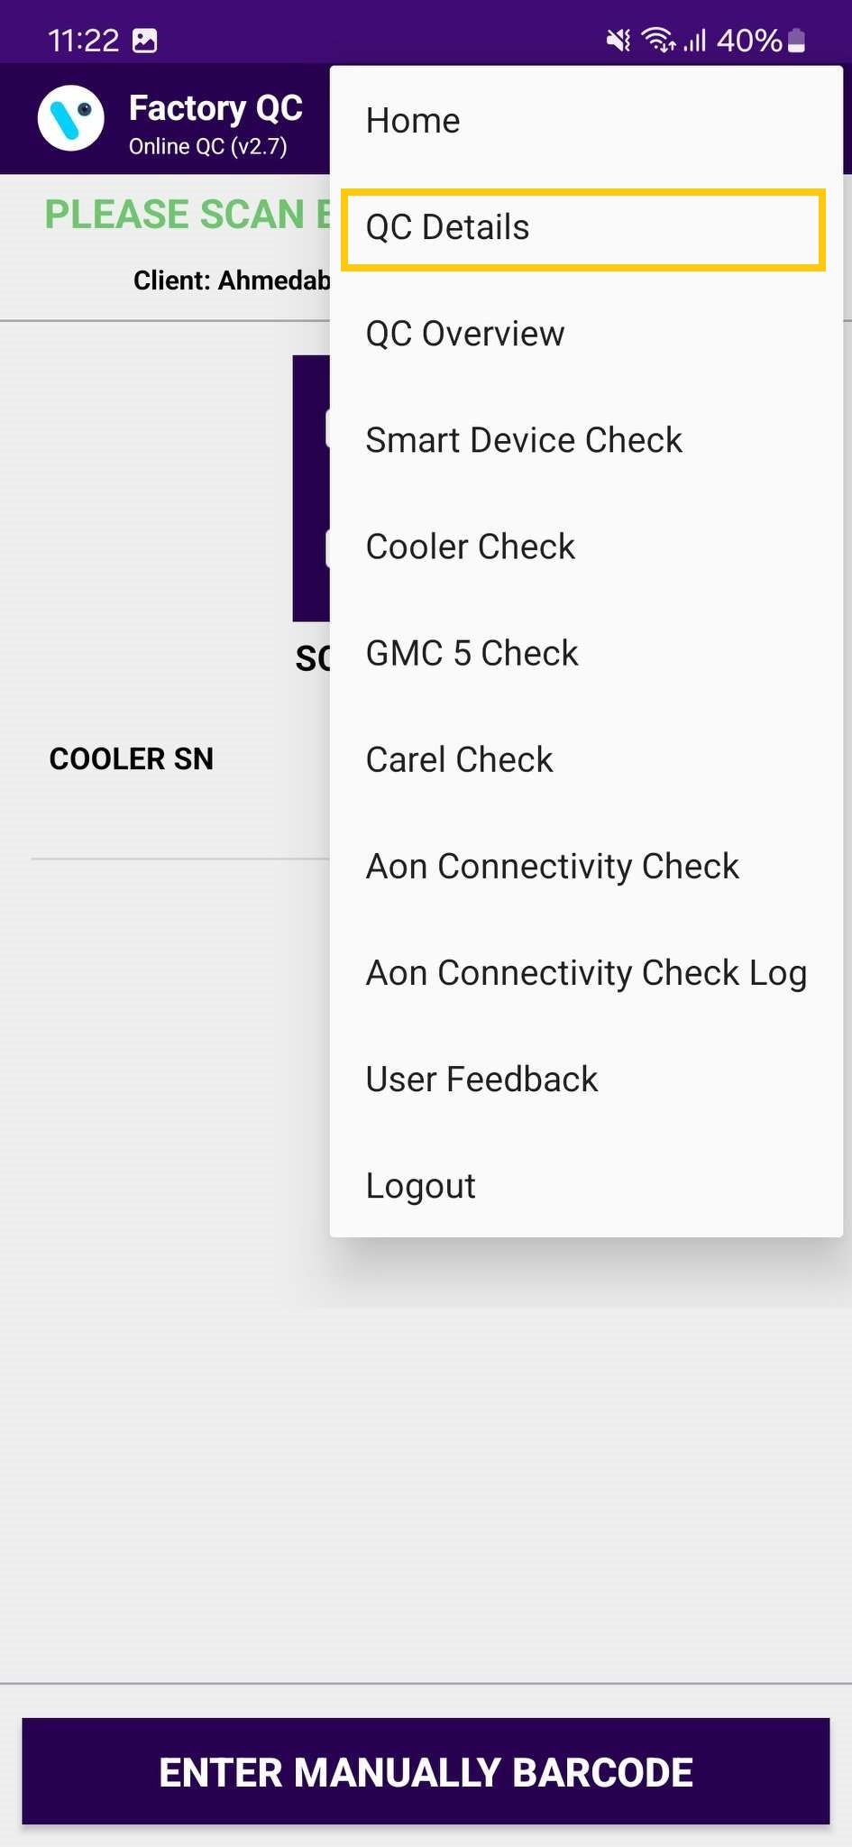
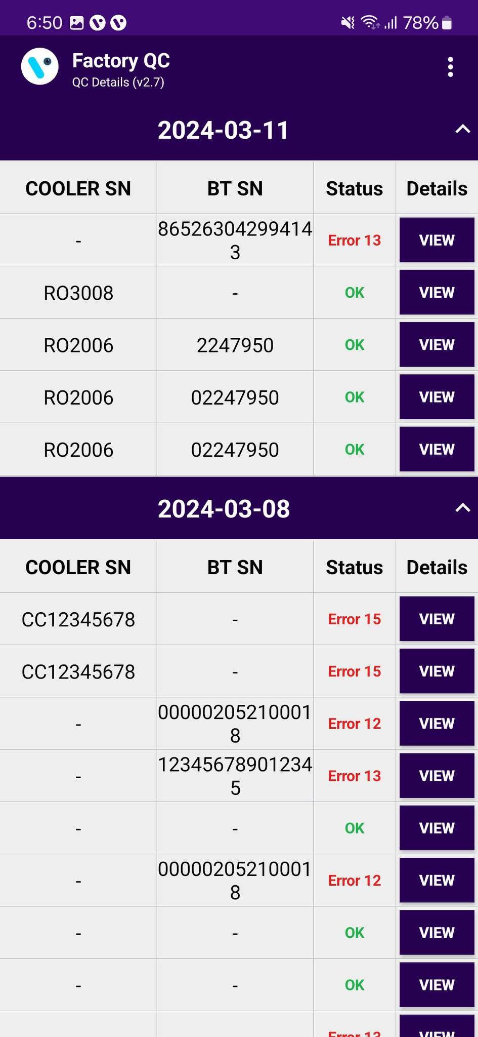
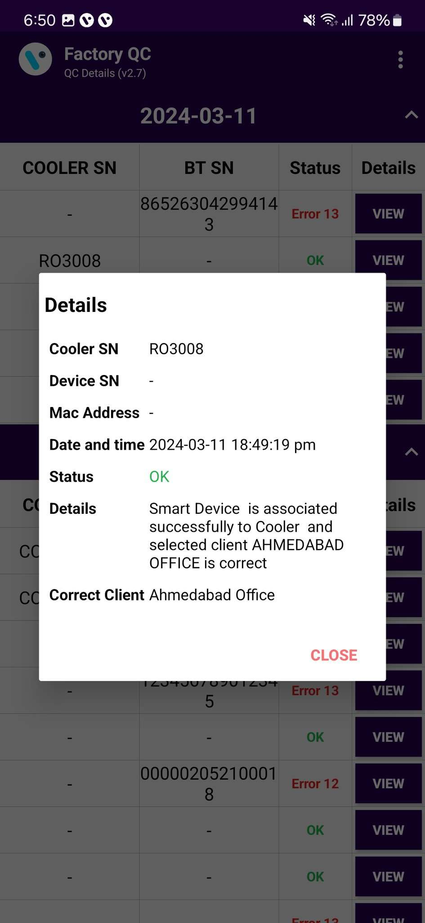
QC DETAILS
QC DETAILS – To Show all the Cooler and smart Device checks done and the results from those checks. If View is tapped, details are shown.
© 2023 Vision Group

Slide 13
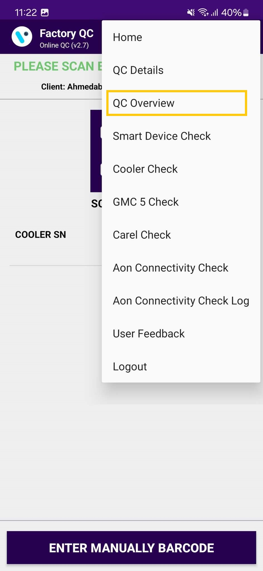
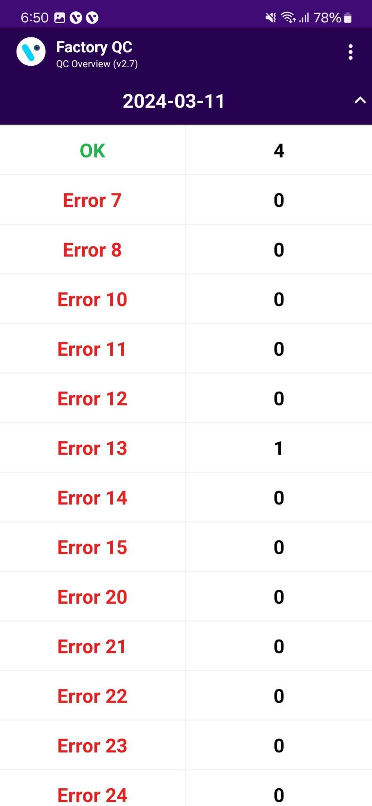
QC OVERVIEW
QC OVERVIEW – To Show an Overview of the Cooler, Smart Device check Association.
© 2023 Vision Group

Slide 14
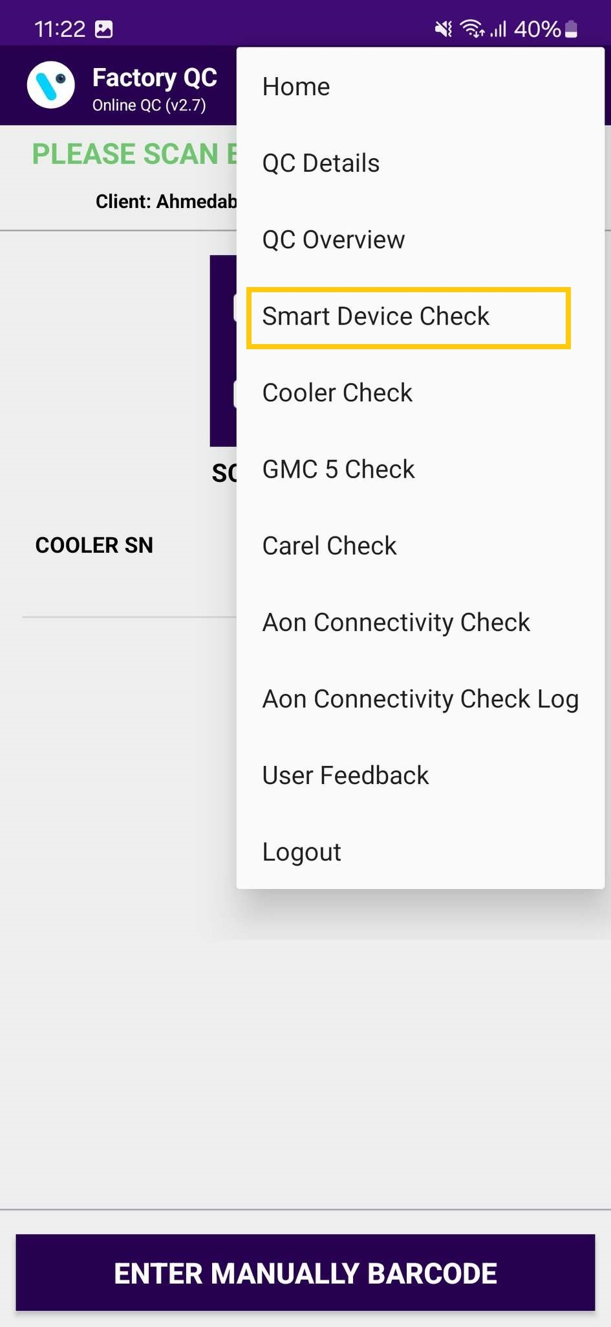
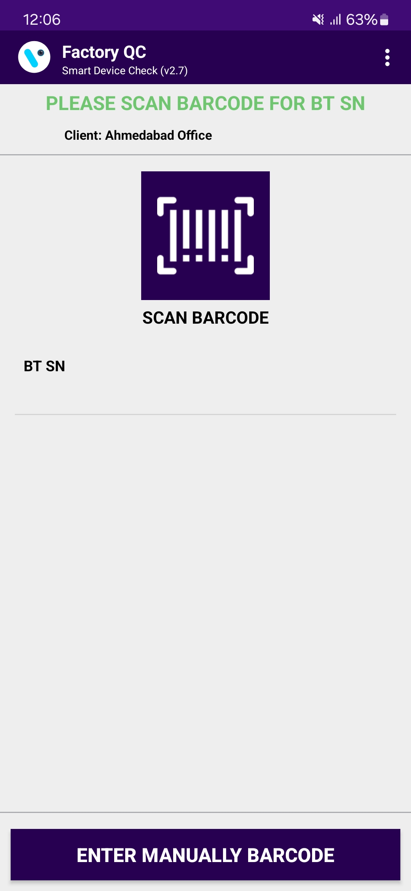
SMART DEVICE CHECK
SMART DEVICE CHECK – To Show an Overview of the Smart Device, in Smart Device Check Association.
© 2023 Vision Group

Slide 15
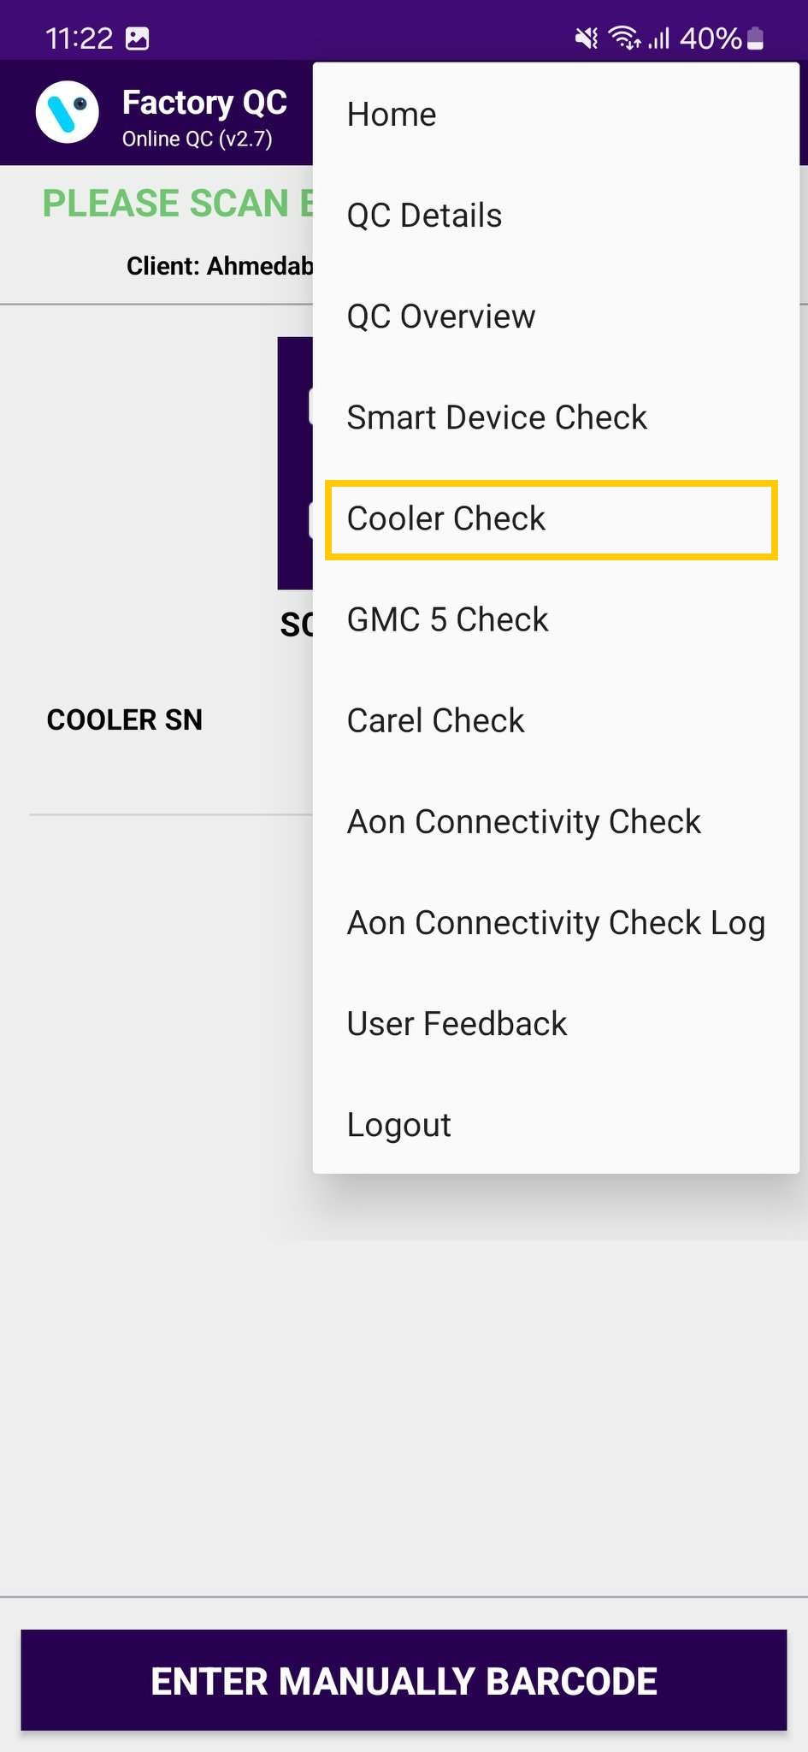
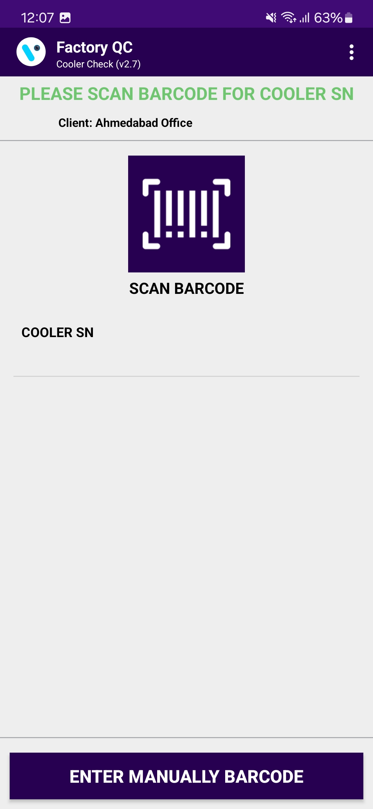
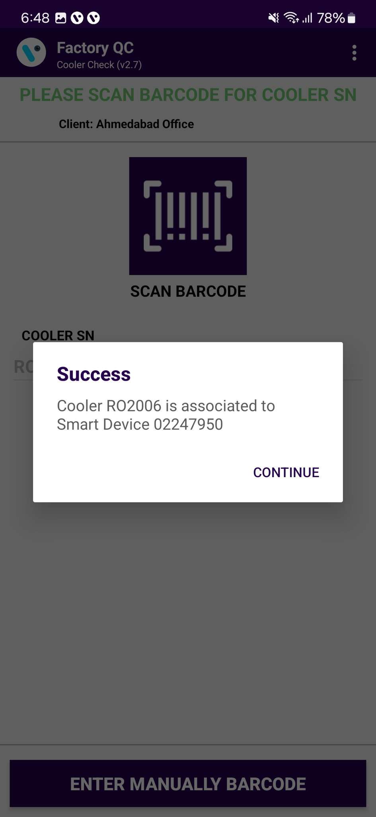
COOLER CHECK
COOLER CHECK – To Show an Overview of the Cooler, in the Cooler Check Association.
© 2023 Vision Group

Slide 16
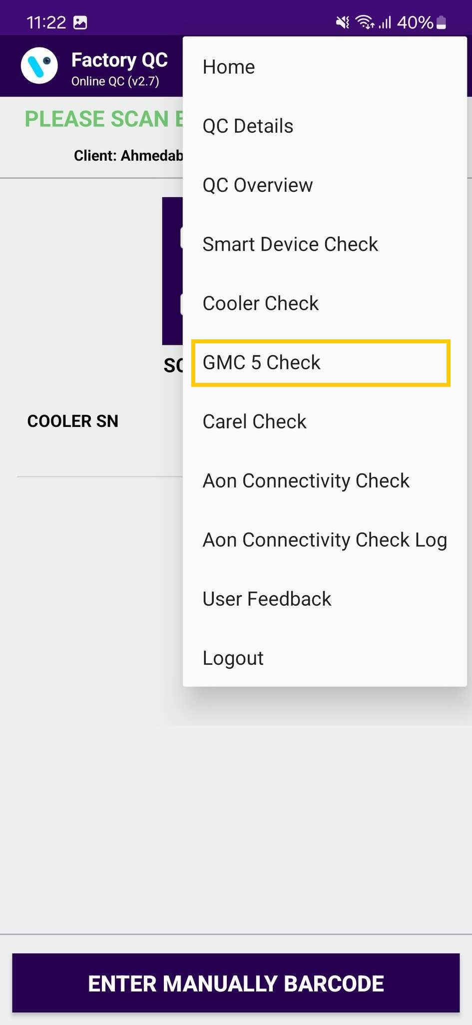
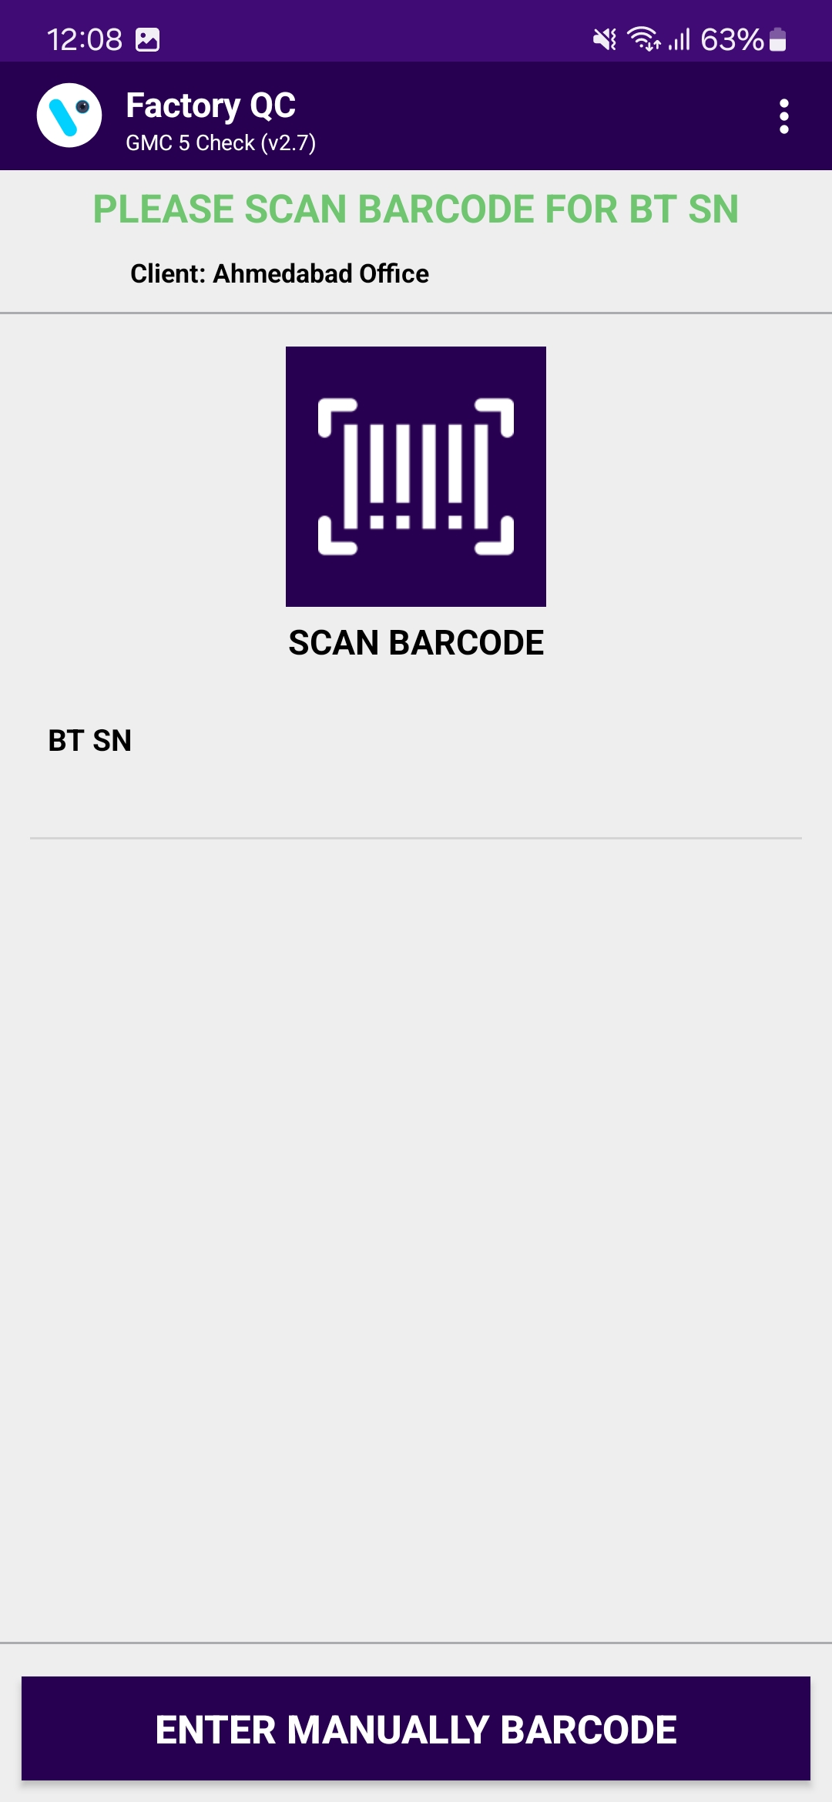
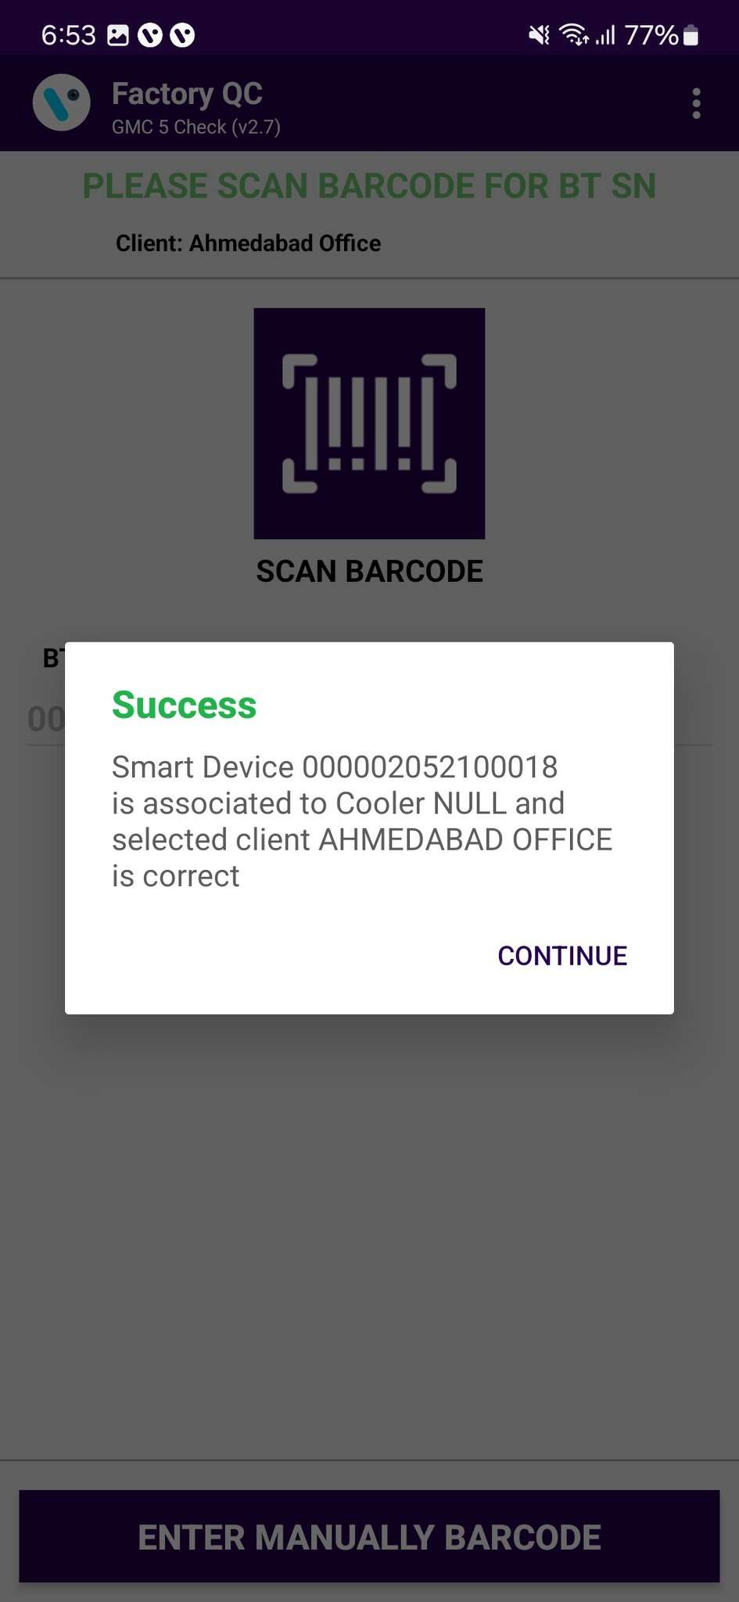
GMC5 CHECK
GMC5 CHECK – To Show an Overview of the Sollatek GMC5 Device, in the GMC5 Check Association.
© 2023 Vision Group

Slide 17

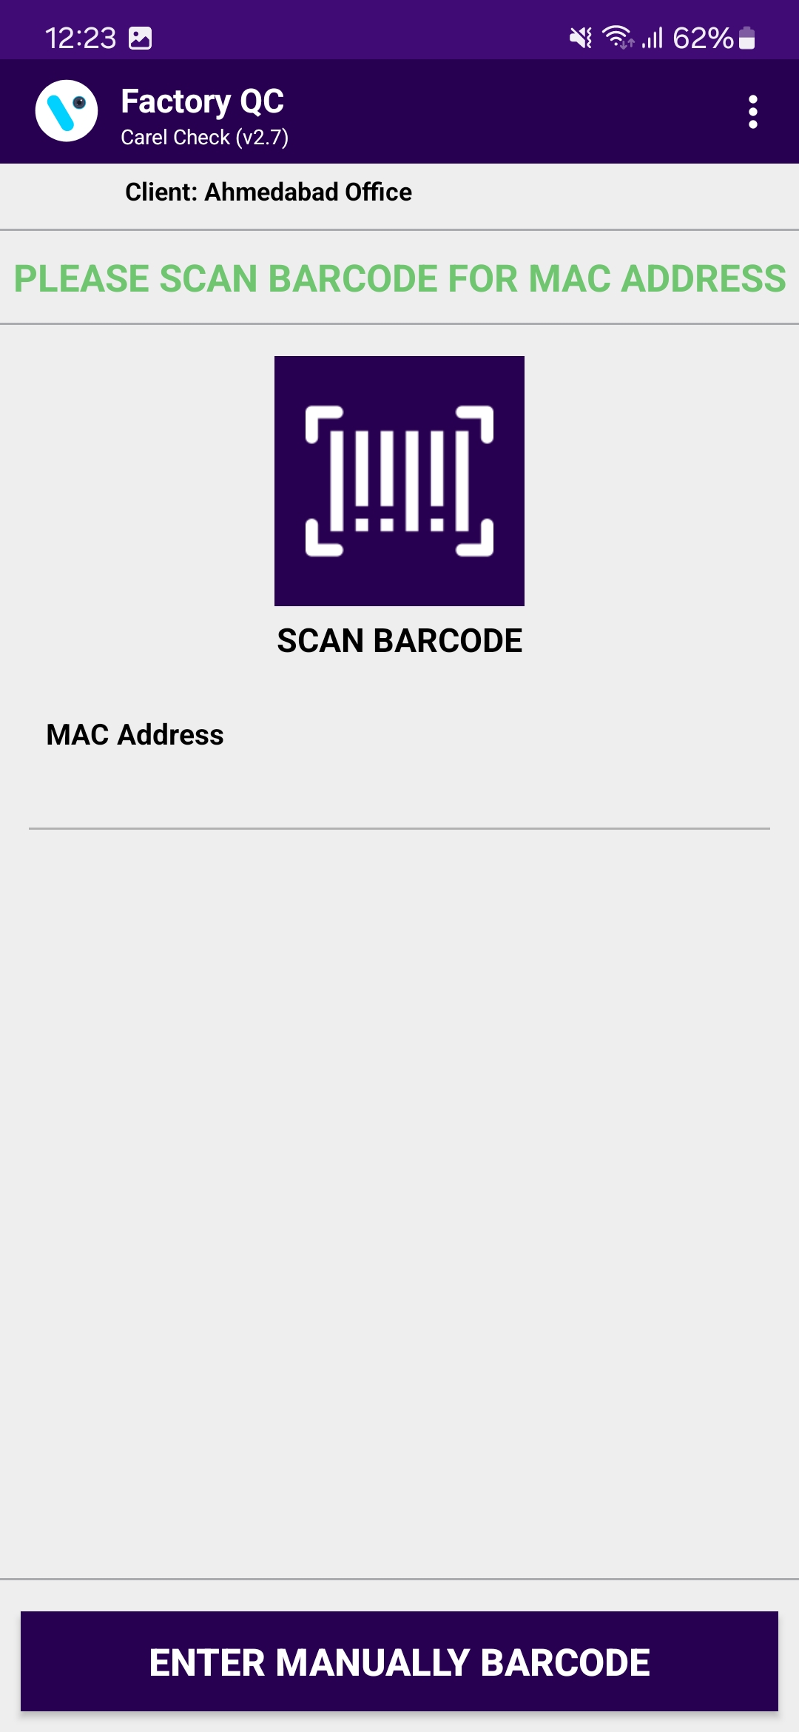
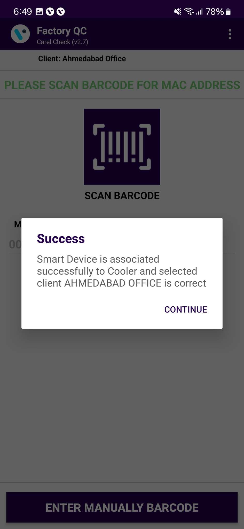
CAREL CHECK
CAREL CHECK – To Show an Overview of the Carel Device, in the Carel Check Association.
© 2023 Vision Group

Slide 18
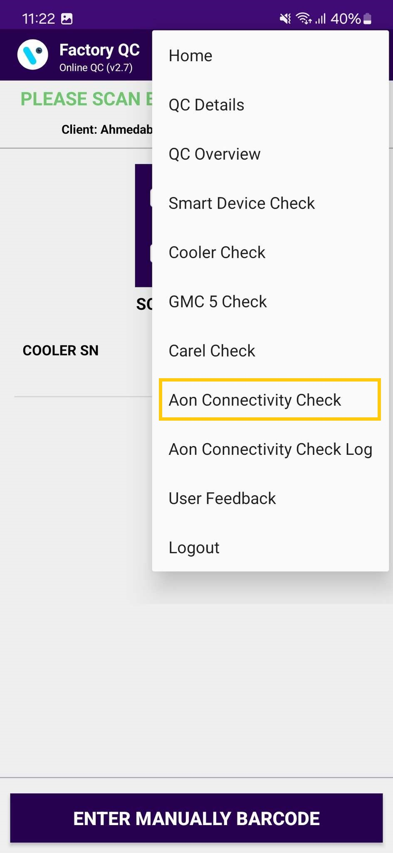
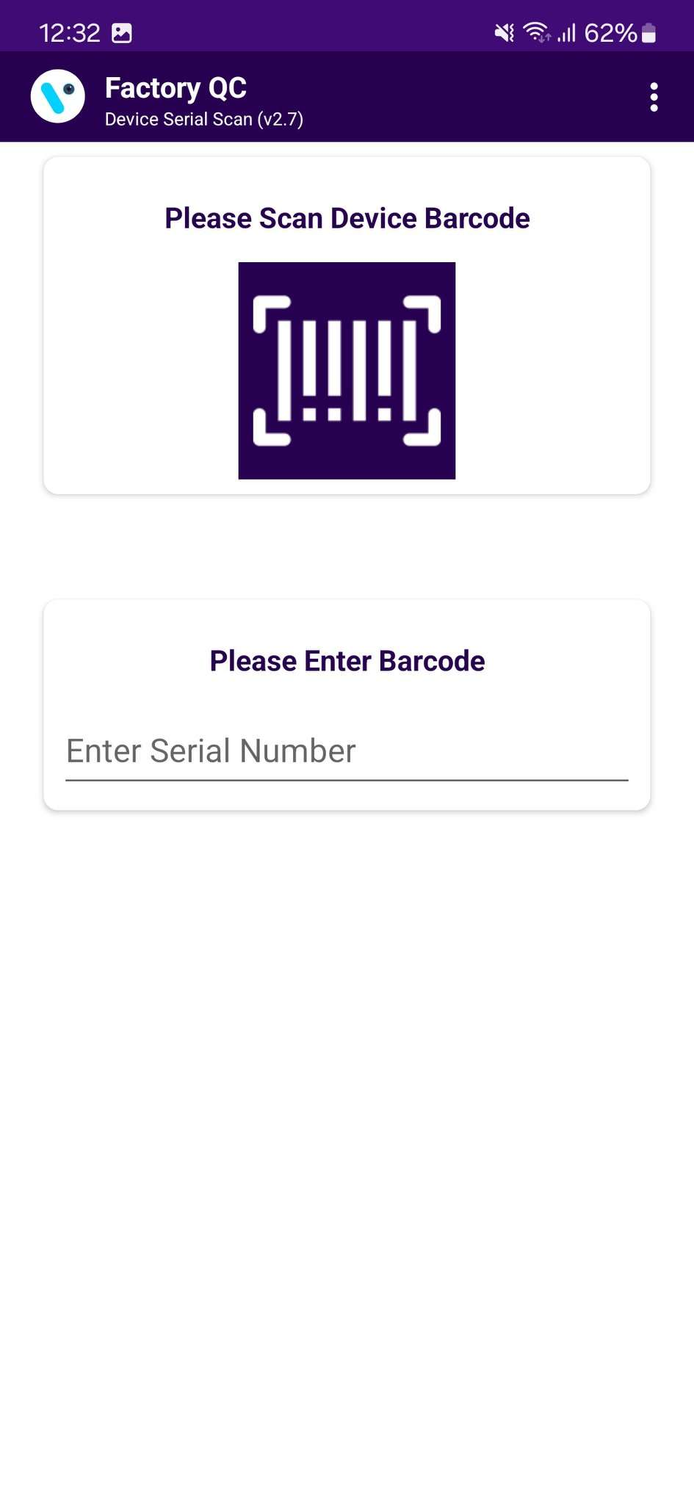
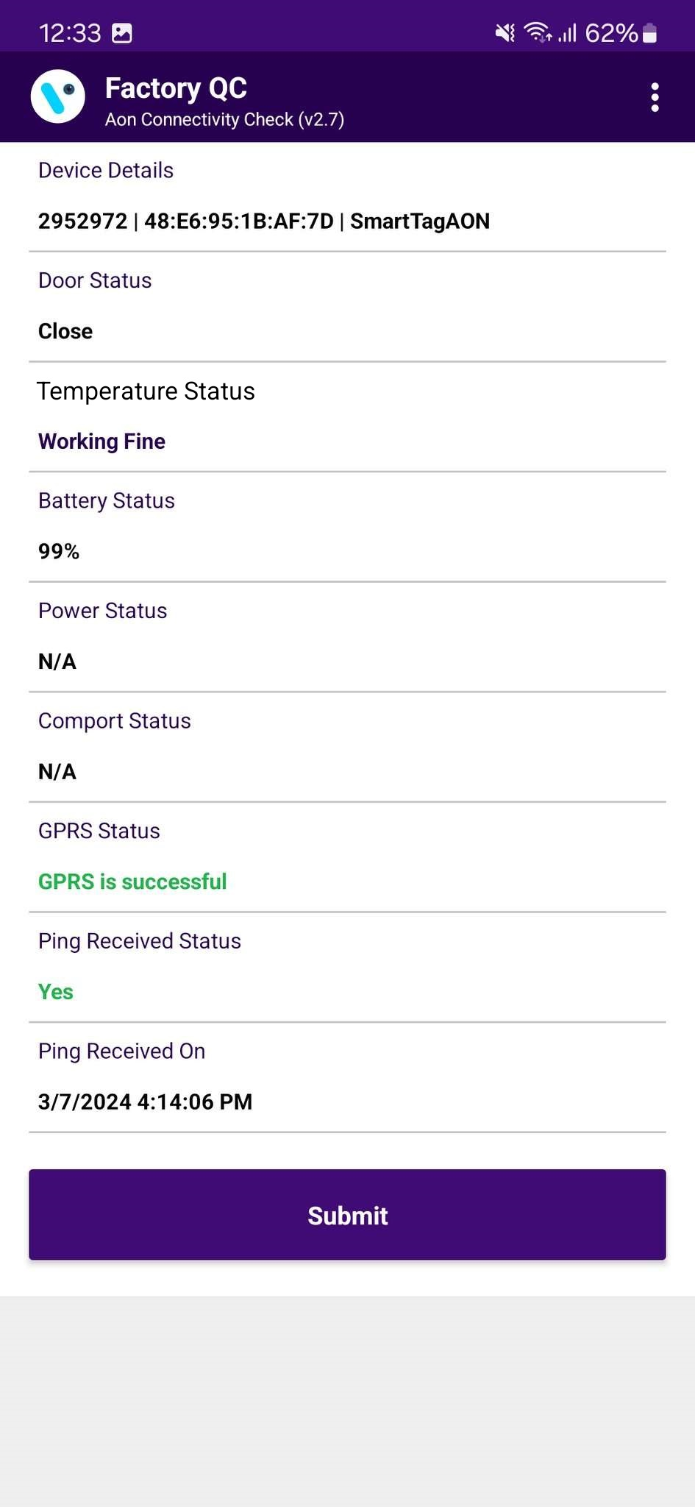
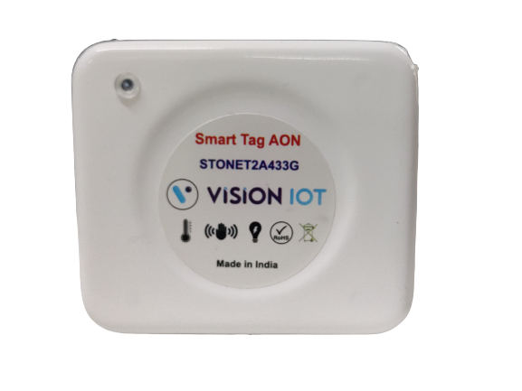
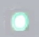
AON CONNECTIVITY CHECK – Smart Tag AON
To check the Advertisement and Ping Status, tap on the hamburger menu in the upper right corner and then tap on Aon Connectivity Check.
For the Smart Tag AON Connectivity check, the user must associate the Smart devices before 15 minutes.
SMART TAG AON: before the check AON Connectivity Status Give 5 to 9 door events within 30 seconds to start the advertisement.
After Checking the AON Connectivity of the Device Must Press the “SUBMIT” button to Save the AON Connectivity Check Logs.
If the device is not found within 120 seconds, the application will display the "Retry" and "Submit" buttons.
GREEN LED – When the Green LED Blinks the user can check the AON Connectivity status.
PURPLE LED* device in cellular mode phone application will not be able to connect and the Device will not come in the advertisement.
SMART TAG AON
© 2023 Vision Group

Slide 19
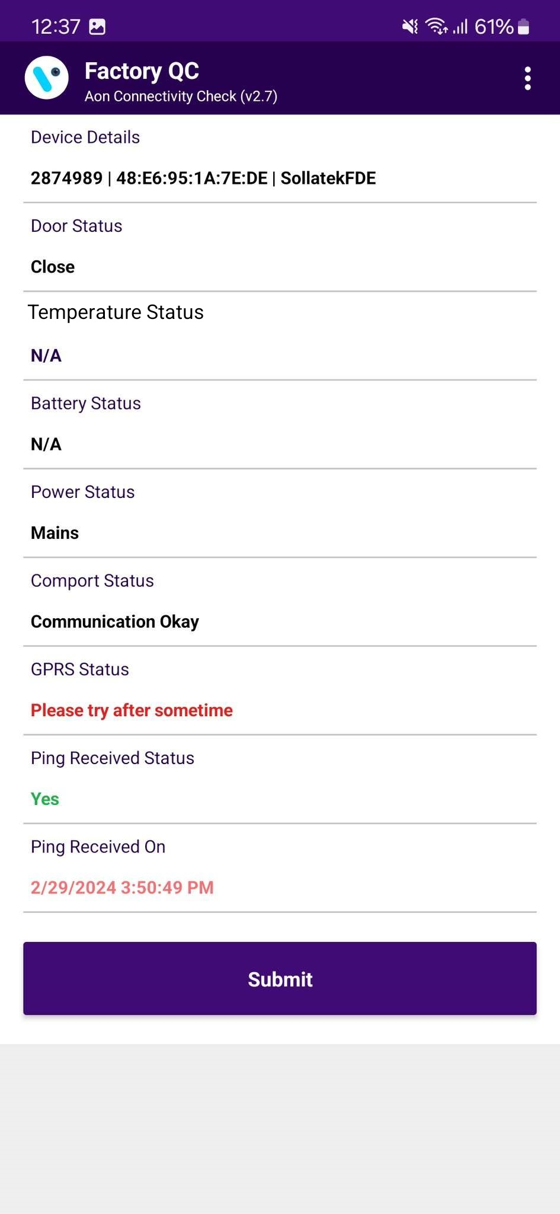
AON CONNECTIVITY CHECK – Sollatek FDEx2
To check the Advertisement and Ping Status, tap on the hamburger menu in the upper right corner and then tap on Aon Connectivity Check.
SOLLATEK FDEx2:
The device Must be powered Minimum of 10 minutes before the AON Connectivity check.
There should not be in GPRS Activity going on with the FDEx2 Device. If it is not coming in the advertisement retry AON check after the 5 minutes with keep it powered ON.
After Checking the AON Connectivity of the Device Must Press the “SUBMIT” button to Save the AON Connectivity Check Logs.
If the device is not found within 120 seconds, the application will display the "Retry" and "Submit" buttons.
SOLLATEK FDEx2
© 2023 Vision Group

Slide 20
AON CONNECTIVITY CHECK
PARAMETERS | VALUE FORMAT | SMART TAG AON | SOLLATEK FDEX2
DEVICE DETAILS | Serial Number | MAC Address | Device Type Name | YES | YES
DOOR STATUS | Open / Close | YES | YES
TEMPERATURE STATUS | Working Fine / Faulty | YES | YES
BATTERY STATUS | Battery % | YES | N/A
POWER STATUS | Mains | N/A | YES
COMPORT STATUS | Communication Okay / Not OK | N/A | YES
GPRS STATUS | Status | YES | YES
PING RECEIVED STATUS | Yes / No | YES | YES
PING RECEIVED ON | Date and Time | YES | YES
© 2023 Vision Group

Slide 21
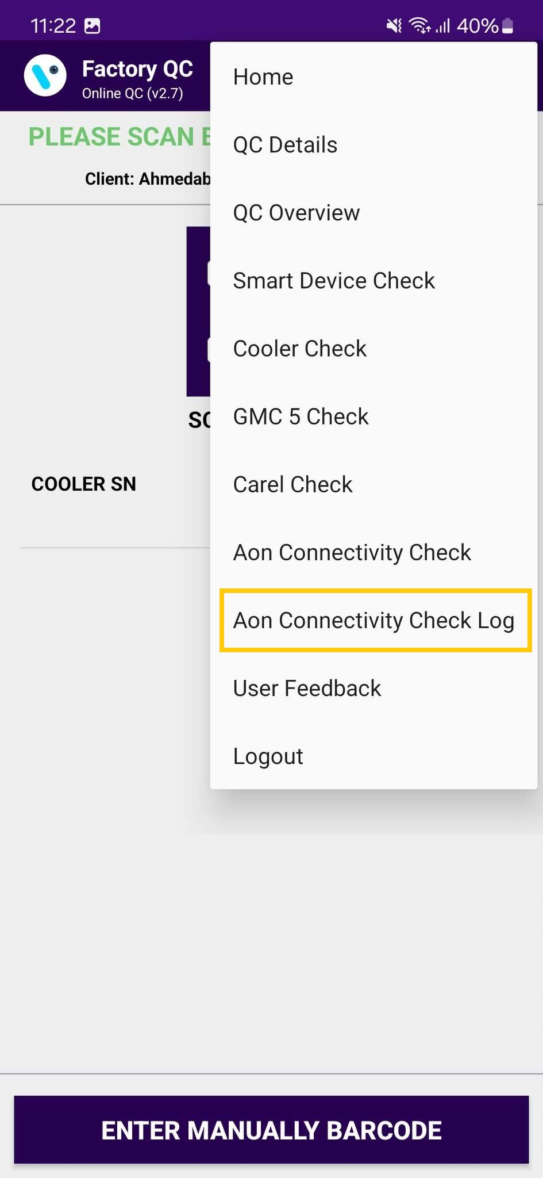
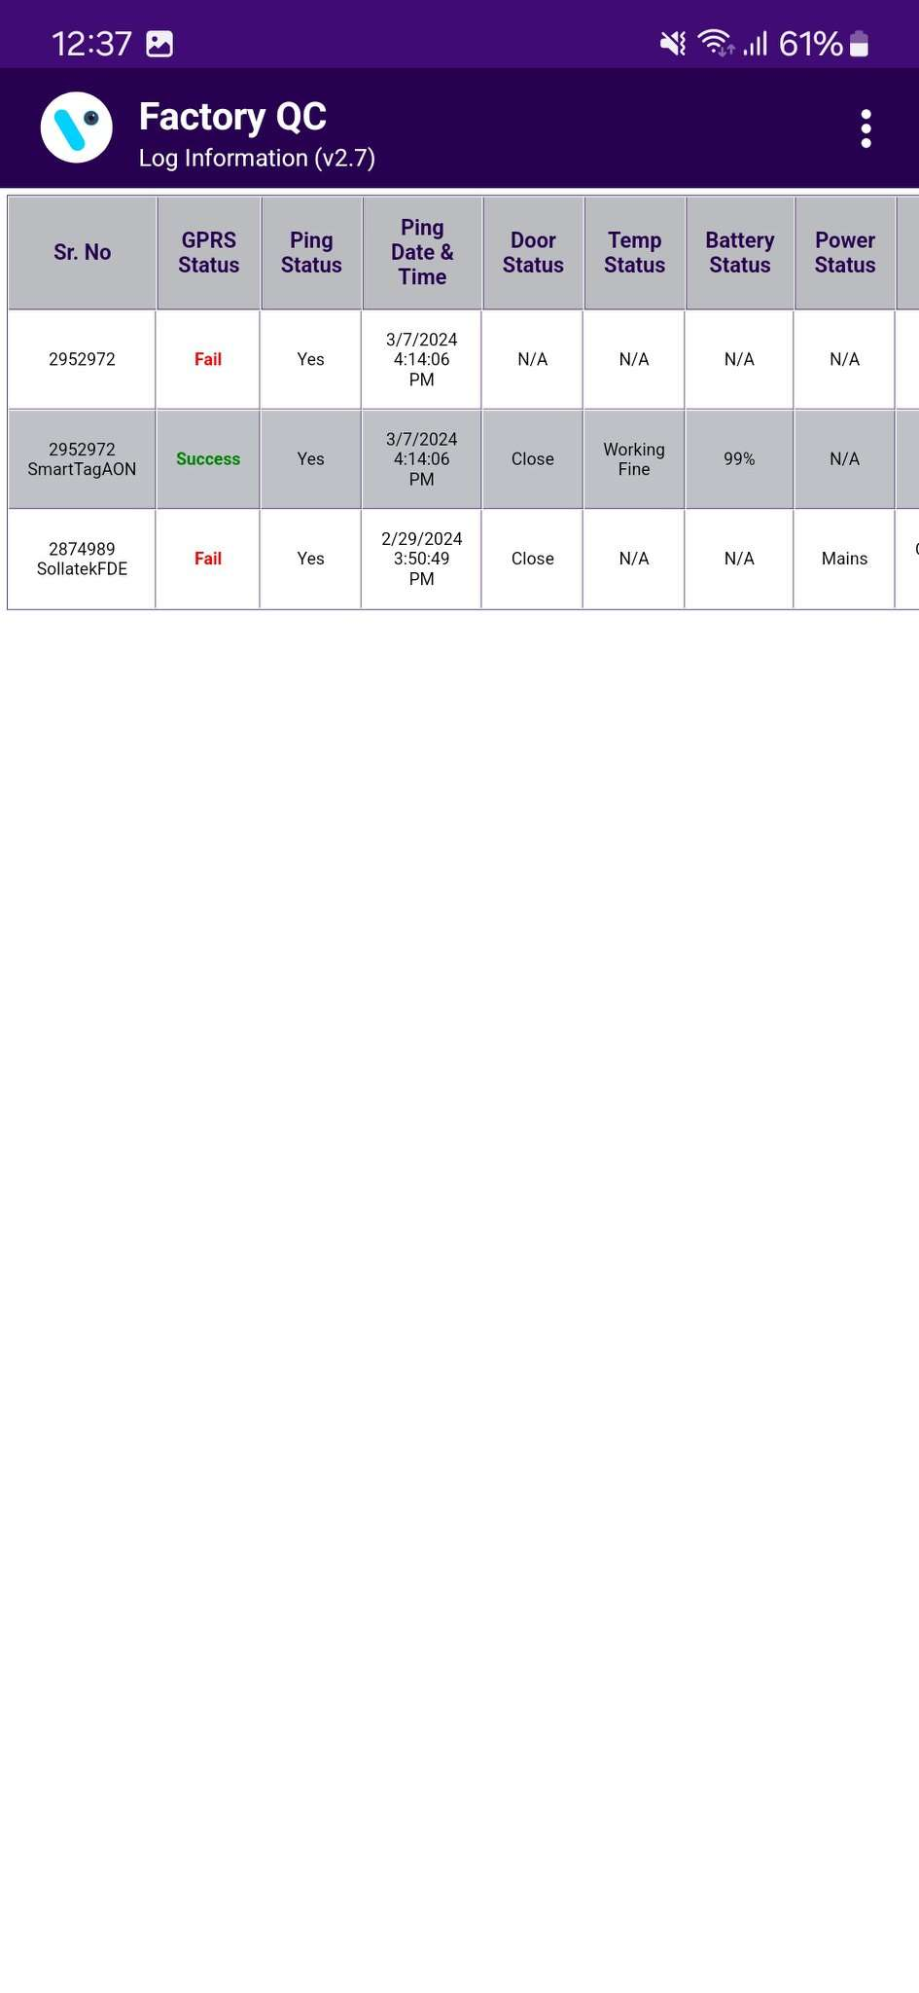
AON CONNECTIVITY CHECK LOG
To check the Advertisement and Ping Status Logs, tap on the hamburger menu in the upper right corner and then tap on Aon Connectivity Check Logs.
The page is Scrollable to see the other parameters to scroll right to left.
© 2023 Vision Group

Slide 22
MESSAGES – OK/Success Messages
SMART DEVICE CHECK
Smart Device <SD SN> is associated to Cooler <COOLER SN> | SUCCESS | The user scans the SD SN, the scanned SD is associated with Cooler SN.
Smart Device <SD SN> is not associated | ERROR 12 | The user scans the SD SN, the scanned SD is not associated.
Smart Device <SD SN> is not in the Portal | ERROR 13 | The user scans the SD SN, the scanned SD is not in the Portal
COOLER CHECK
Cooler <COOLER SN> is associated to Smart Device <SD SN> | SUCCESS | The user scans the Cooler SN, the scanned Cooler is associated with SD SN.
Cooler <COOLER SN> is not associated | ERROR 14 | The user scans the Cooler SN, the scanned Cooler is not associated.
Cooler <COOLER SN> is not in the Portal | ERROR 15 | The user scans the Cooler SN, the scanned Cooler is not in the Portal
© 2023 Vision Group

Slide 23
MESSAGES – ALERTS Messages
Detailed Message | Short Message | User Story
Smart Device <SD SN> is associated successfully to Cooler <COOLER SN> and <CLIENT ID> is correct | SUCCESS | The user scans the SD SN and Cooler SN, the scanned SD, and Cooler are associated successfully.
Please check your internet connection and try again | ERROR 01 | No Internet
Cannot connect to server, please try again | ERROR 02 | No Internet or server not available
Smart Device <SD SN> and Cooler <COOLER SN> are not associated | ERROR 07 | The user scans the SD SN and Cooler SN, the scanned SD is not associated, the scanned Cooler is not associated.
Smart Device <SD SN> is not associated and Cooler <COOLER SN> is not in the Portal | ERROR 08 | The user scans the SD SN and Cooler SN, the scanned SD is not associated, the scanned Cooler is not in the Portal.
Smart Device <SD SN> is not in the portal and Cooler <COOLER SN> is not associated | ERROR 10 | The user scans the SD SN and Cooler SN, the scanned SD is not in the Portal, the scanned Cooler is not associated.
Smart Device <SD SN> and Cooler <COOLER SN> are not in the Portal | ERROR 11 | The user scans the SD SN and Cooler SN, the scanned SD is not in the Portal, the scanned Cooler is not in the Portal.
© 2023 Vision Group

Slide 24
MESSAGES – ERROR Messages
Detailed Message | Short Message | User Story
Smart Device <SD SN> is associated successfully to Cooler <COOLER SN> and <CLIENT ID> is incorrect | ERROR 20 | The user scans the SD SN and Cooler SN, the scanned SD and Cooler are associated successfully, but the client is incorrect.
Smart Device <SD SN> is associated to <COOLER SN> and Cooler <COOLER SN> associated to Smart Device <SD SN> and the <CLIENT ID> is incorrect | ERROR 21 | The user scans the SD SN and Cooler SN, the scanned SD is associated with a different Cooler, and the client selected is incorrect, than the one scanned. The scanned Cooler is also associated with a different SD than the one scanned.
Smart Device <SD SN> is associated to <COOLER SN> and Cooler <COOLER SN> associated to Smart Device <SD SN> and the <CLIENT ID> is correct | ERROR 22 | The user scans the SD SN and Cooler SN, the scanned SD is associated to a different Cooler, and the client selected is correct, than the one scanned. The scanned Cooler is also associated with a different SD than the one scanned.
Smart Device <SD SN> is associated to <COOLER SN> and Cooler <COOLER SN> is not associated and the <CLIENT ID> is correct | ERROR 23 | The user scans the SD SN and Cooler SN, the scanned SD is associated with a different Cooler than the one scanned, the scanned Cooler is not associated, but the client is correct.
Smart Device <SD SN> is associated to <COOLER SN> and Cooler <COOLER SN> is not associated and <CLIENT ID> is incorrect | ERROR 24 | The user scans the SD SN and Cooler SN, the scanned SD is associated to a different Cooler than the one scanned, the scanned Cooler is not associated, and the client is incorrect.
Smart Device <SD SN> is associated successfully to Cooler <COOLER SN> and <CLIENT ID> is incorrect | ERROR 20 | The user scans the SD SN and Cooler SN, the scanned SD and Cooler are associated successfully, but the client is incorrect.
Smart Device <SD SN> is associated to <COOLER SN> and Cooler <COOLER SN> associated to Smart Device <SD SN> and the <CLIENT ID> is incorrect | ERROR 21 | The user scans the SD SN and Cooler SN, the scanned SD is associated with a different Cooler, and the client selected is incorrect, than the one scanned. The scanned Cooler is also associated with a different SD than the one scanned.
Smart Device <SD SN> is associated to <COOLER SN> and Cooler <COOLER SN> associated to Smart Device <SD SN> and the <CLIENT ID> is correct | ERROR 22 | The user scans the SD SN and Cooler SN, the scanned SD is associated to a different Cooler, and the client selected is correct, than the one scanned. The scanned Cooler is also associated with a different SD than the one scanned.
© 2023 Vision Group

Slide 25
Detailed Message | Short Message | User Story
Smart Device <SD SN> is associated to <COOLER SN> and Cooler <COOLER SN> is not associated and the <CLIENT ID> is correct | ERROR 23 | The user scans the SD SN and Cooler SN, the scanned SD is associated with a different Cooler than the one scanned, the scanned Cooler is not associated, but the client is correct.
Smart Device <SD SN> is associated to <COOLER SN> and Cooler <COOLER SN> is not associated and <CLIENT ID> is incorrect | ERROR 24 | The user scans the SD SN and Cooler SN, the scanned SD is associated to a different Cooler than the one scanned, the scanned Cooler is not associated, and the client is incorrect.
Smart Device <SD SN> is associated to <COOLER SN> and Cooler <COOLER SN> is not in the Portal and the <CLIENT ID> is correct | ERROR 25 | The user scans the SD SN and Cooler SN, the scanned SD is associated with a different Cooler than the one scanned, the scanned Cooler does not exist in the Portal, but the client is correct.
Smart Device <SD SN> is associated with <COOLER SN> and Cooler <COOLER SN> is not in the Portal and the <CLIENT ID> is incorrect | ERROR 26 | The user scans the SD SN and Cooler SN, the scanned SD is associated with a different Cooler than the one scanned, the scanned Cooler does not exist in the Portal, but the client is incorrect.
Smart Device <SD SN> is not associated and Cooler <COOLER SN> is associated to Smart Device <SD SN> and the <CLIENT ID> is correct | ERROR 27 | The user scans the SD SN and Cooler SN, the scanned SD is not associated, the scanned Cooler is associated to a different SD than the scanned, but the client is correct.
Smart Device <SD SN> is not associated and Cooler <COOLER SN> is associated to Smart Device <SD SN> and the <CLIENT ID> is incorrect | ERROR 28 | The user scans the SD SN and Cooler SN, the scanned SD is not associated, the scanned Cooler is associated to a different SD than the scanned, but the client is incorrect.
Smart Device <SD SN> is not in the Portal and Cooler <COOLER SN> is associated to Smart Device <SD SN> and the <CLIENT ID> is correct | ERROR 29 | The user scans the SD SN and Cooler SN, the scanned SD is not in the Portal, the scanned Cooler is associated with a different SD than the one scanned and the client is correct.
Smart Device <SD SN> is not in the Portal and Cooler <COOLER SN> is associated to Smart Device <SD SN> and the <CLIENT ID> is incorrect | ERROR 30 | The user scans the SD SN and Cooler SN, the scanned SD is not in the Portal, the scanned Cooler is associated with a different SD than the one scanned, but the client is not correct.
© 2023 Vision Group

Slide 26
Thank You!
© 2023 Vision Group

